Slide 1


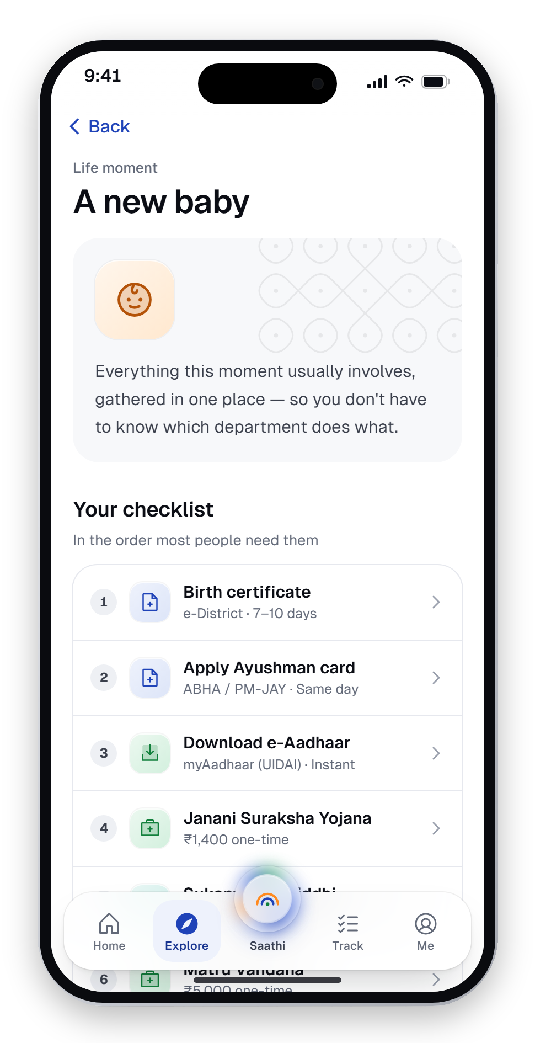
साथी
SAATHI
Hack-O-Octo 4.0 · Chandigarh University
Hack-O-Octo 4.0 · Open Innovation Challenge
One door to every
government service.
Saathi — a smart-city citizen services app with an AI assistant that asks before it acts. Our Open Innovation entry.
PRESENTED BY
DEPARTMENT
Krishom Sharma
UIC
BCA (UI/UX Designs)
University Institute of Computing
UID — 24BCU10002
A design concept. Not affiliated with the Government of India.

Slide 2
6 services. 6 portals.
One tired parent.
A BABY IS BORN IN KANPUR
Birth certificate
Ayushman card
e-Aadhaar
With Saathi
e-District
ABHA / PM-JAY
myAadhaar · UIDAI
1 checklist.
Janani Suraksha
Sukanya Samriddhi
Matru Vandana
One login, one language, one door.
Health Department
Bank / Post Office
Women & Child Dev.
The six services of the “A new baby” life moment, as modelled in the Saathi prototype.

Slide 3






The problem isn't missing services. It's the maze.
India built the rails of a digital state. Citizens still can't find the front door.
“
142 crore+
23.2 billion
70 crore+
मुझे पता है कि सब online है, but मुझे ये नहीं पता कि कौन सा online असली है.
Aadhaar numbers issued
UPI payments in May 2026
DigiLocker accounts
The rails are built →
“I know everything's online — I just don't know which ‘online’ is the real one.”
Language
Forms fall back to English.
Trust
Fake portals, paid middlemen.
Rakesh, 34 — shopkeeper, Kanpur · user research
Where to start
Sorted by department, not by life.

Slide 4
Who we're building for
Four personas from conversations in cities, small towns and villages.
RV
SD
VS
AS
Rakesh, 34
Sunita, 29
Vikram, 68
Ananya, 26
Tier-2 · Kanpur
Rural · Bihar
Senior · Chennai
Urban · Bengaluru
PAIN
PAIN
PAIN
PAIN
Burned by fake portals
Low literacy, one shared phone
Prefers Tamil, needs time
Zero patience for friction
NEEDS
NEEDS
NEEDS
NEEDS
Trust he can verify
Voice + read-aloud
Large text, slow mode
Done in 2 minutes

Slide 5
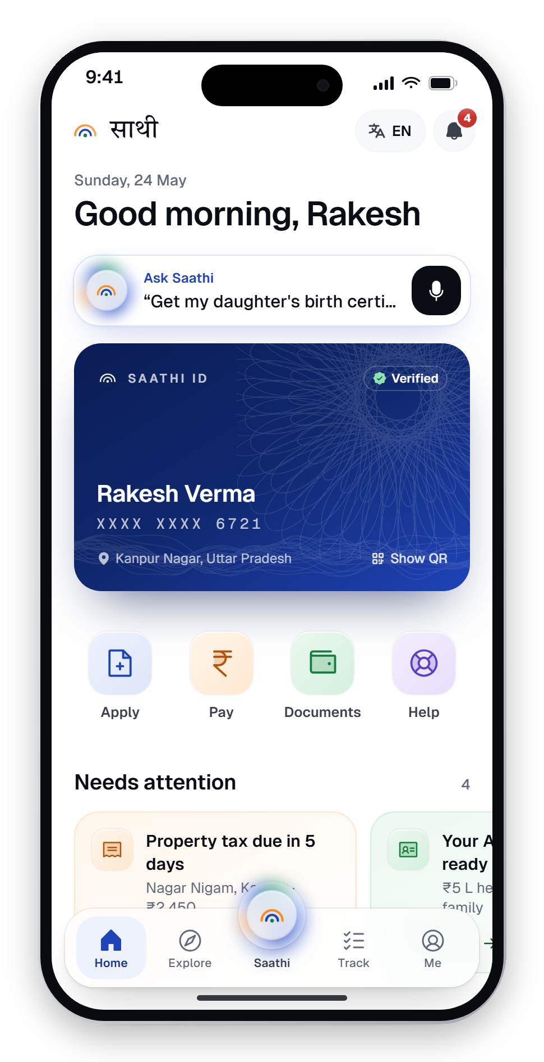



Saathi — one door, organised around life
A smart-city citizen app that starts from what's happening to you, not from a department.
Life moments
A birth, a job, a move — every department involved, as one checklist.
An AI agent that asks first
Tell it what you need; it plans, cites sources, takes consent, then acts.
Your language, your voice
17 languages live, voice on every field, read-aloud and slow mode.
Both sides of the counter
15 department consoles push decisions to the citizen, live.

Slide 6






Key flow — Saathi AI asks before it acts
Rakesh asks for his daughter's birth certificate, in Hindi. Four steps, one consent, real proof.
01
Ask
02
Plan
03
Approve
04
Done
मेरी बेटी का जन्म प्रमाणपत्र बनवाना है
Fetch the hospital birth record from DigiLocker
Share with Nagar Nigam, Kanpur?
Application submitted
Fill Form 1 for e-District
Your name and address
SAA-2026-457029
Aanya's hospital birth record
Priya Nair is reviewing it
“I need to get my daughter's birth certificate”
Certificate expected in 7 days
Check Janani Suraksha Yojana eligibility
Valid until the application closes
You may also get ₹1,400 under Janani Suraksha Yojana.
By voice or text, in any of 17 languages
Submit to Nagar Nigam, Kanpur
Approve
Edit
Nothing leaves the phone without a yes
Every step names its official source

Slide 7
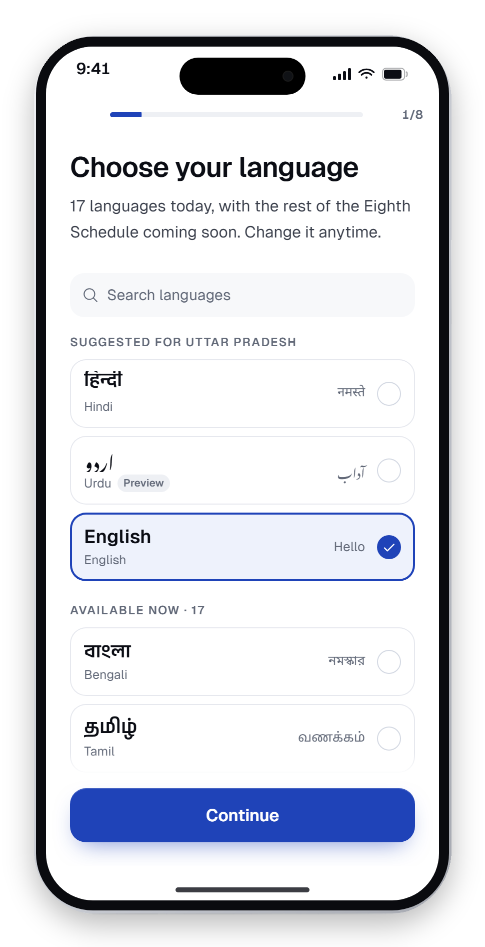
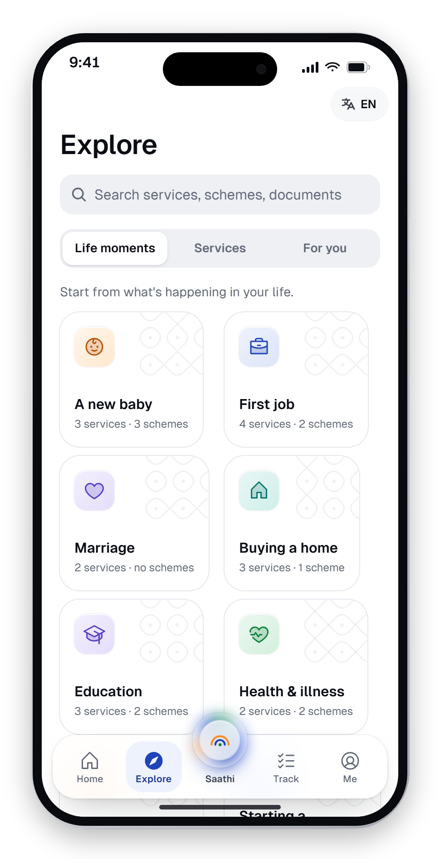
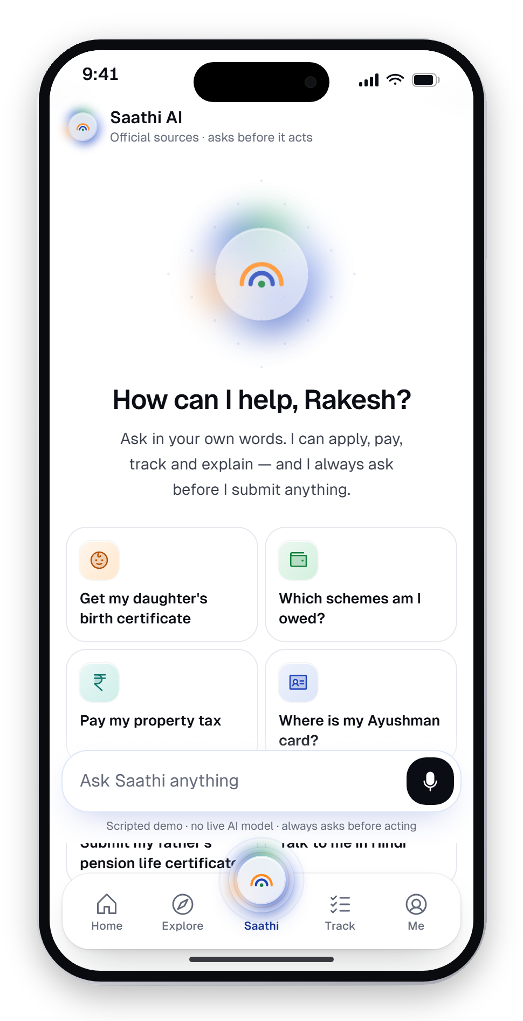
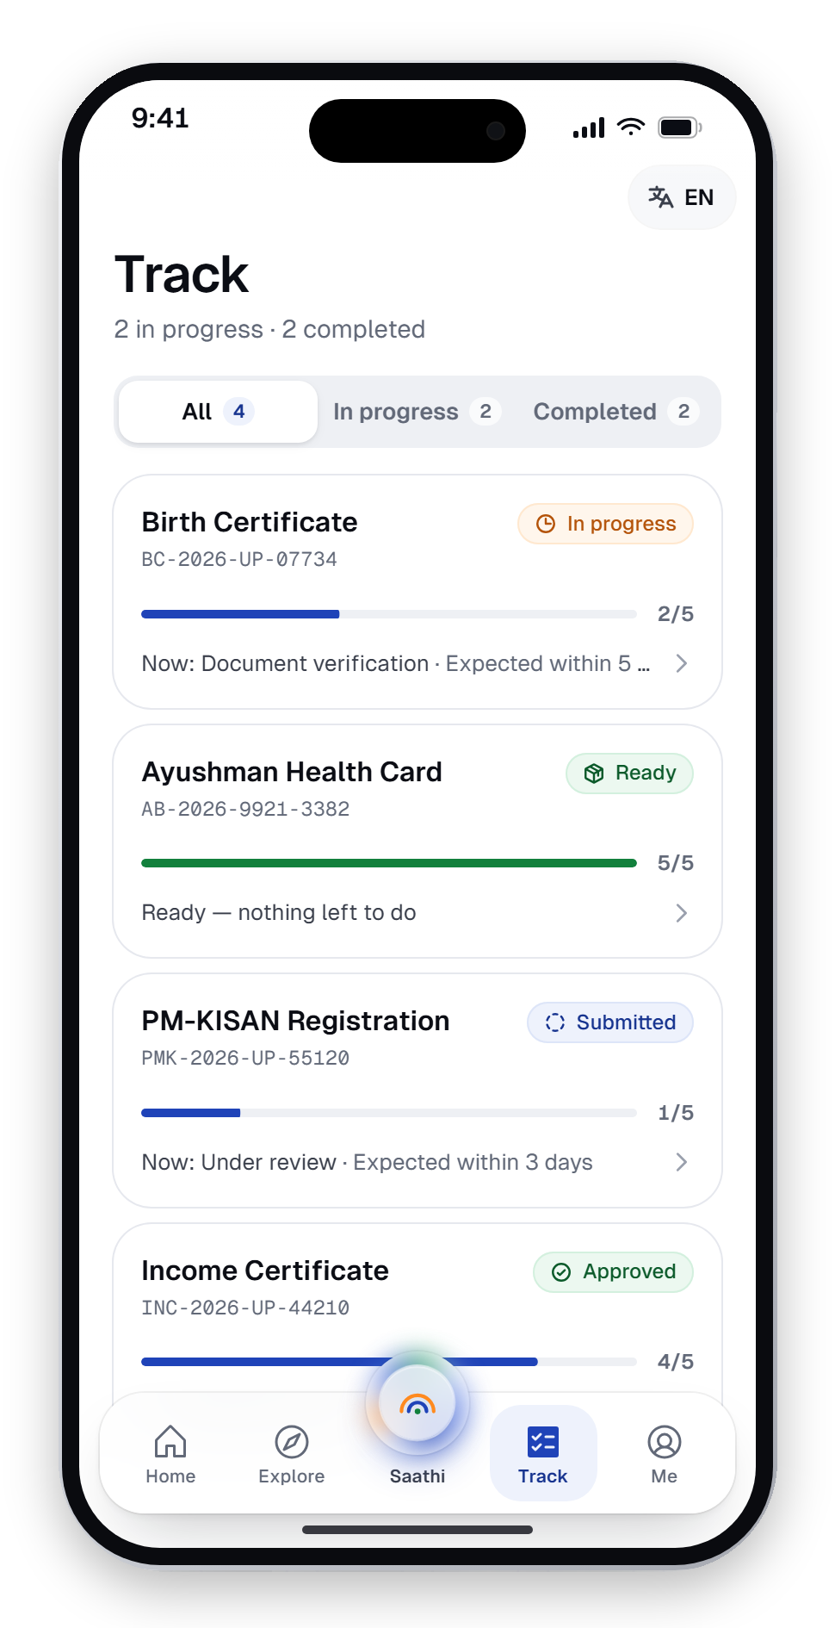
Designed end to end
Not a mock-up — a clickable prototype with every screen built.
Onboarding
Explore
Saathi AI
Track
Language first, then consent
Services by life moment
Ask in any words
Named officers, real dates

Slide 8
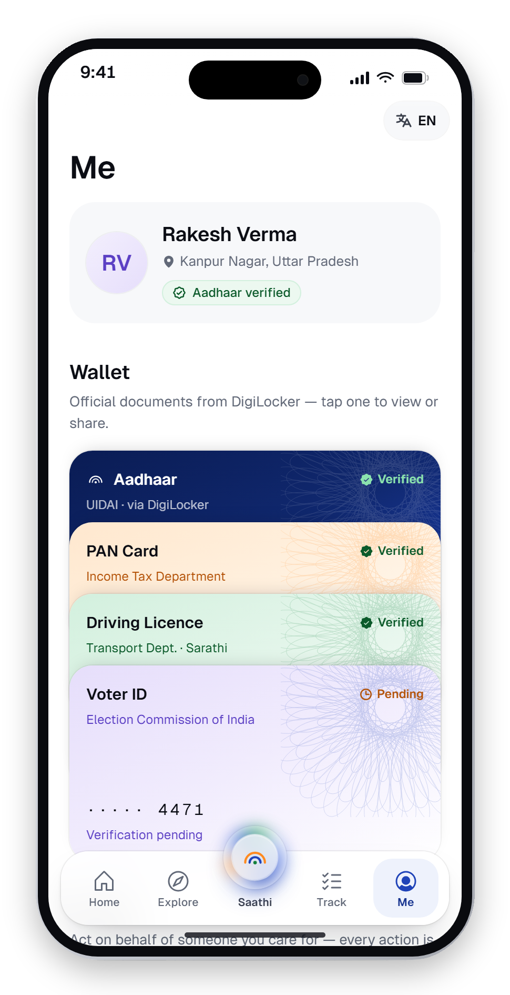
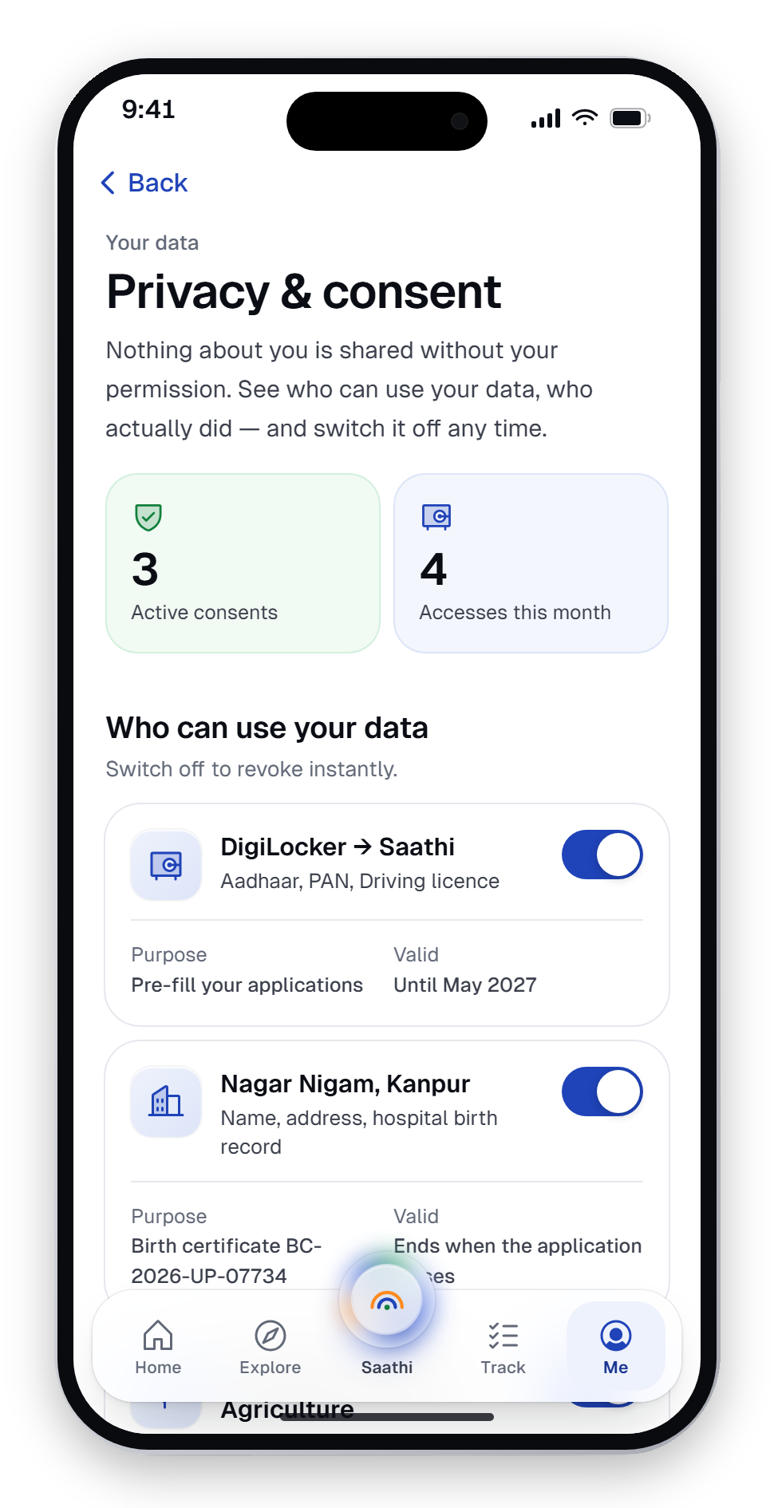
Trust you can see
A wallet, a checklist and a privacy dashboard that shows who used your data.
A new baby
Me
Privacy & consent
Home
6 services, 1 checklist
Tinted document wallet
Access log, one-tap revoke
What needs attention

Slide 9
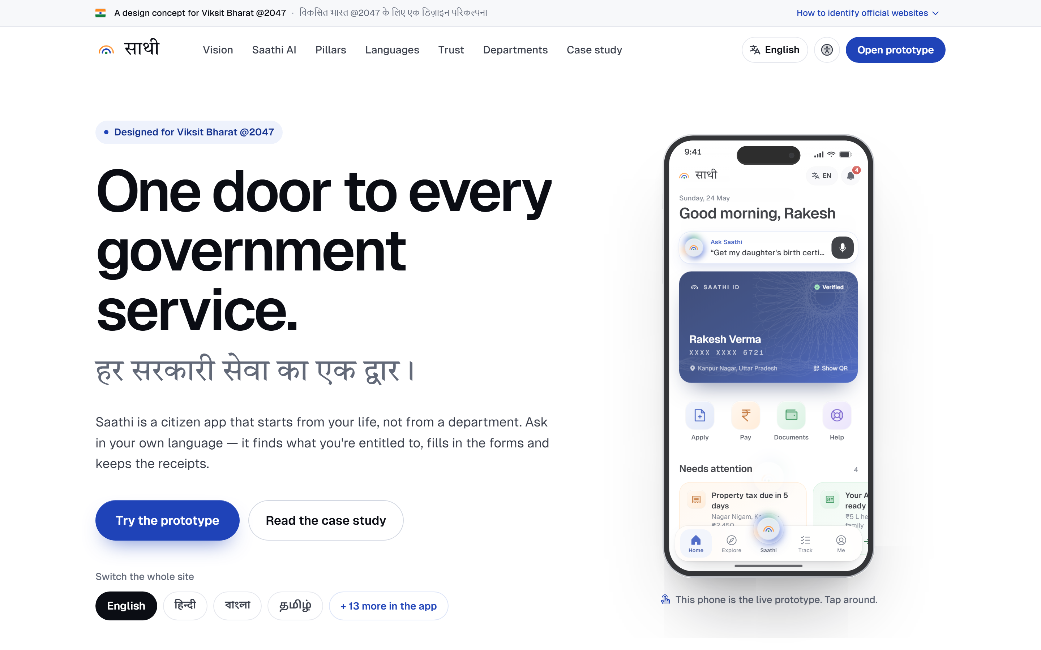
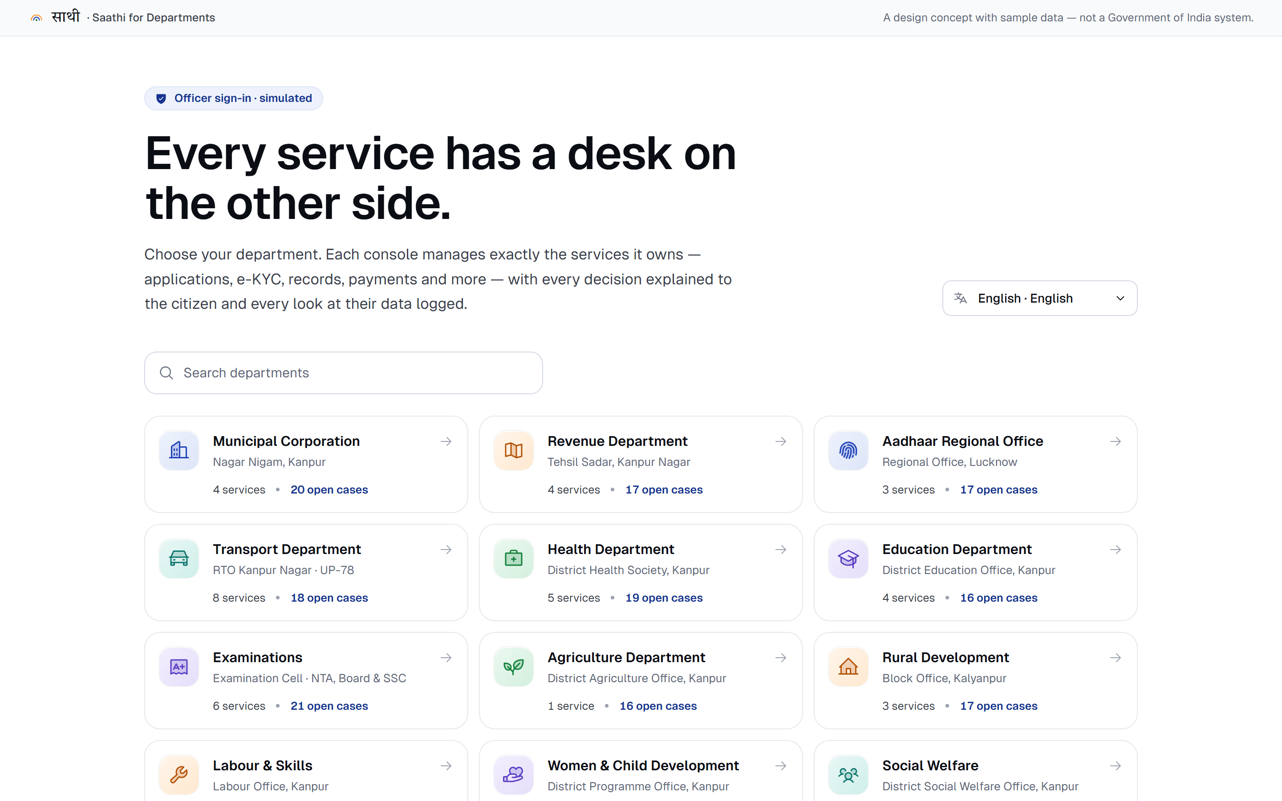
Both sides of the counter
The citizen's website and the officer's console — every decision reaches the citizen live, in their language.
Website — “One door to every government service”, with the live prototype embedded
Saathi for Departments — 15 consoles, masked e-KYC, audit trail

Slide 10




Design system — Bharat Precision
Calm enough to trust with a pension, precise enough to feel world-class.
COLOUR WITH A JOB
Kolam & guilloche
TYPE ACROSS SCRIPTS
Chakra Navy
Aa
Precision.
Imagery made in code — kolam line art and security linework. No stock photos, no maps.
#1F43B8 · Actions, links, focus
India Green
Phosphor, one family
#12803C · Verified, approved, done
साथी
நான் உதவலாம்
Regular for chrome, duotone for tiles, fill for the active tab.
Saffron
#FF8A1F · Highlights — never body text
Geist for Latin UI · Instrument Serif for one emotive word · Anek (Ek Type, an Indian foundry) for Indic headlines · Noto Sans for Indic body at 1.8 line-height (UX4G) · Tiro Devanagari for the wordmark.
Motion with a reason
Ink
UI motion under 300 ms, always interruptible; fades only for reduced motion.
#0B0D14 · Text
White
Contrast, tested
#FFFFFF · Every surface
Every text colour checked ≥ 4.5:1 against WCAG 2.1 AA in automated tests.

Slide 11
What changes for the citizen
Today's experience versus Saathi, side by side.
 | Today | With Saathi
Finding a service | Know the department and the app's name | Start from a life moment, or just ask
Language | English forms, typed by hand | 17 languages, voice on every field
Help | Pay an agent or a CSC operator | An assistant that plans and fills forms
Consent | Data shared, nobody says with whom | Who, what, why, until when — then Approve
Status | Call the office, wait | Timeline with named officers and dates
Your data | No idea who looked at it | Access log and one-tap revoke

Slide 12




Six ideas that make it new
The open-innovation bet: design the door, not another app.
Life-moment bundling
Agent with a consent gate
Vernacular-first
Every department a life event touches, as one checklist.
Acts on identity and money only after an explicit yes.
Designed in Hindi and Tamil first; script swaps in 200 ms.
Two-sided by design
Visible data access
Proxy is first-class
Officer decisions reach the citizen's app live.
See every officer who opened your documents.
Help a parent with a persistent “helping Sunita” banner.

Slide 13




Already built — and runs today
Feasibility isn't a promise here. It's a working build.
42
17
15
6
real government processes
languages live
department consoles
AI missions, end to end
Front end
Next.js 14 · React 18 · TypeScript · Tailwind · Framer Motion — static export, no install
Languages
next-intl · 23 locale folders · per-script fonts — Bhashini-ready for voice
AI agent
Scripted & reviewable: intents → missions → consent pause → outcome · Vitest-tested
Integrations
Designed for Aadhaar, DigiLocker, UPI, API Setu, CPGRAMS (conceptual today)

Slide 14




Business model & scale (proposed)
A public good, sold to the public sector — city by city, on rails that already exist.
Customer
Model
Municipal corporations and state e-governance departments — starting with Smart Cities Mission cities.
B2G: a one-time city rollout plus annual support. Free for every citizen — no ads, no data selling.
Why it's cheap to scale
How a city wins
Static front end; departments plug in through API Setu; languages through Bhashini. No new data silos.
Fewer counter visits, fewer agents, measurable completion rates and a grievance trail it can audit.
Go-to-market: hackathon prototype → one pilot city (municipal, RTO, health desks) → three states → every district.

Slide 15
Impact we'll measure
Design targets for a pilot — set before testing, so the idea can be judged honestly.
5 min
90%
0
1 in 3
to apply for a birth certificate, from a first tap
complete a key flow without help
submissions or payments without consent
fields filled by voice, low-literacy users
VIKSIT BHARAT PILLARS
गरीब
युवा
अन्नदाता
नारी
Garib — entitlements find people
Yuva — licences on a train ride
Annadata — PM-KISAN by voice
Nari — one checklist after a birth
SDG 11
Sustainable cities
SDG 16
Strong institutions
SDG 10
Reduced inequalities
SDG 9
Innovation

Slide 16


Live demo — 90 seconds
Everything in the prototype works. Here's the path we'll show.
01
Switch to हिन्दी
The whole app re-typesets instantly — no reload.
02
“मेरी बेटी का जन्म प्रमाणपत्र बनवाना है”
Saathi plans, cites DigiLocker and e-District, waits for Approve.
03
Approve it as the officer
Open Nagar Nigam's console — the citizen's Track updates live.
04
Revoke a consent
Privacy dashboard: see who accessed your data, switch it off.

Slide 17

Not another app. The door to all of them.
WHY SAATHI WINS
Real problem
Working build
Safe AI
Ready to scale
Every citizen, every city
42 flows · 17 languages
Never acts without a yes
Built on India Stack
WHAT WE'RE ASKING FOR
Mentorship, a pilot partner city, and access to Bhashini and API Setu sandboxes to take Saathi from prototype to pilot.
Thank you — questions welcome.

